Slide 1


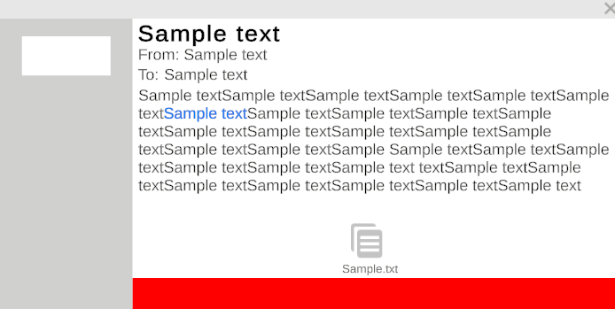
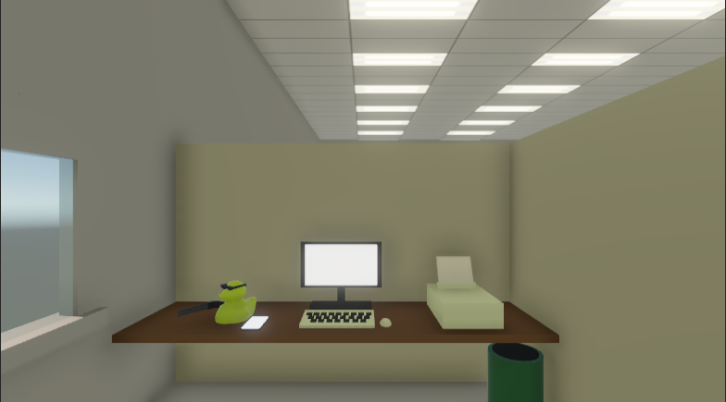
Contra-Hacker
Contra-Hacker
Phishing and Social engineering
Work simulator for administrative work
Hectic multitasking
The cyber security awareness game

